Slide 1
Leadership Academy
Notes:
Joseph-
Welcome
History of Leadership Academy at Oregon Tech
Thank you to Sacramento State

Slide 2
Objectives
Leadership Academy Mission: To provide students with opportunities to develop effective leadership, clear objectives, goals, and long-term direction for their campus involvement areas and in their futures.
Develop students’ leadership and professional skills
Serve as a foundation for involvement in campus life
Promote retention, academic success, and graduation
The Leadership Academy is a certificate program facilitated through the Campus Life office.
Notes:
Joseph- Mission and goals
Sac State
“It is designed to develop students’ leadership and professional skills, serve as a foundation for involvement in campus life, and promote retention, academic success, and graduation.”

Slide 3
Leadership Academy Partners
Academic Programs
Student
Affairs
Community
Notes:
All from sac state
Assessment Practices
Qualitative Data
Workshop Written Reflections
Video Reflections
Quantitative Data
Multi-Institutional Study of Leadership
Office of Institutional Research Reports
Use the Socially Responsible Leadership Scale (SRLS)
S/W – What does your office do well? What is your office known for? Where do you spend most of your time and resources?
O/T – Who do you already have partnerships with? What other partnerships could you build that would be mutually beneficial? What would these partnerships entail?
What is your vision for your program at your institution?
Challenge - You have no funding for your leadership program, what aspects (or would any aspects) of your program change?

Slide 4
Leadership Academy
Connection & Outreach
Teamwork & Service
Communication
Diverse Perspectives
Wellness
Professional Development
Growth & Personal Development
Notes:
Using a model from the Sacramento State’s Leadership Initiative and adapting it to our 6 ISLOs, we have identified these 6 “areas of growth” which will be the pillars of Oregon Tech’s Leadership Academy. These 6 topics have been selected to help
CSUF-
Servant Leadership
Commitment to Servant Leadership
Can we simply volunteer to help those in need without also working to understand the underlying injustices or exploring the social and political issues involved? Here at Volunteer Service Programs we asked ourselves that very question. The answer came with the creation of Students ACT, a student-driven social action group focused on education, empowerment and action. Working collaboratively with other student organizations, campus departments, and off-campus agencies, Students ACT coordinates an annual Social Justice Summit and other educational programming. Moreover, all the projects here at the Volunteer Service Programs from Community Connection to Project Earth are more than one day volunteer events; they provide opportunities to serve the community, while also illuminating the root causes of problems facing our world. It is in the act of providing service and the dedication to directly addressing social issues that students here on campus are working to create lasting change. Our motto, “It’s Your World... Change It,” is not just an empty promise. It is what we believe.
4 Pillars of Servant Leadership
Leadership through SERVICE
Leadership through CIVIC ENGAGEMENT
Leadership through ADVOCACY & ACTIVISM
Leadership through APPLICATION OF ACADEMIC KNOWLEDGE & SKILL

Slide 5
ESSENTIAL LEARNING OUTCOMES
Leadership Academy
Communication
Teamwork
Ethical Reasoning
Diverse Perspectives
Quantitative Literacy
Inquiry & Analysis
Notes:
CSUF-
Servant Leadership
Commitment to Servant Leadership
Can we simply volunteer to help those in need without also working to understand the underlying injustices or exploring the social and political issues involved? Here at Volunteer Service Programs we asked ourselves that very question. The answer came with the creation of Students ACT, a student-driven social action group focused on education, empowerment and action. Working collaboratively with other student organizations, campus departments, and off-campus agencies, Students ACT coordinates an annual Social Justice Summit and other educational programming. Moreover, all the projects here at the Volunteer Service Programs from Community Connection to Project Earth are more than one day volunteer events; they provide opportunities to serve the community, while also illuminating the root causes of problems facing our world. It is in the act of providing service and the dedication to directly addressing social issues that students here on campus are working to create lasting change. Our motto, “It’s Your World... Change It,” is not just an empty promise. It is what we believe.
4 Pillars of Servant Leadership
Leadership through SERVICE
Leadership through CIVIC ENGAGEMENT
Leadership through ADVOCACY & ACTIVISM
Leadership through APPLICATION OF ACADEMIC KNOWLEDGE & SKILL

Slide 6
INSTUTIONAL LEARNING OUTCOMES
Leadership Academy
Communication
Communication is the creation, development, and expression of ideas through oral and/or written forms. Both forms of communication involve purposeful presentation designed to increase knowledge, to foster understanding, or to promote change in attitudes, values, beliefs, or behaviors.
Teamwork
Teamwork encompasses the ability to accomplish group tasks and resolve conflict within groups and teams while maintaining and building positive relationships within these groups. Team members should participate in productive roles and provide leadership to enable an interdependent group to function effectively.
Ethical Reasoning
Inquiry and analysis consists of posing meaningful questions about situations and systems, gathering and evaluating relevant evidence, and articulating how that evidence justifies decisions and contributes to students’ understanding of how the world works.
Inquiry & Analysis
Inquiry and analysis consists of posing meaningful questions about situations and systems, gathering and evaluating relevant evidence, and articulating how that evidence justifies decisions and contributes to students’ understanding of how the world works.
Quantitative Literacy
Quantitative literacy comprises the ability to appropriately extract, interpret, evaluate, construct, communicate, and apply quantitative information and methods to solve problems and support decisions in students’ everyday professional, civic, and personal lives.
Diverse Perspectives
Recognition of diverse perspectives comprises the self-awareness, intellectual flexibility, and broad knowledge that enables perception of the world through the eyes of others.3 This includes the awareness and understanding of the customs, practices, and viewpoints of varied cultures, individuals, …. & identities. …. ..

Slide 7
Sample Complete 1st Year
Leadership Academy
Connection & Outreach
Teamwork & Service
Communication
Professional Development
Wellness
Diverse Perspectives
LA Workshop
Volunteer Trip & Debrief
LA Workshop
Health Science Club Medical Ethics
ISHC Healthy Living Workshop
DC Cultural Hour
Elective:
Safe Zone Training
Elective:
Tech Talk
Elective:
International Dinner
Elective:
Sexual Assault Prevention Talk
Notes:
Because we are starting late in academic year, we have condensed the number of events
15 events= 1 per week for the rest of the 2015 (no dead week/finals/break)
27 weeks in the full academic year (no dead week/finals/break)
I think we can keep it at 15 for 2015-2016
That’s about 1 event every 2 weeks
Year 1: 10 Points
10 Qualifying Events
1 Qualifying Event from each development category
4 “Elective Opportunities”
Leadership Academy will provide at least 1 workshop for each ISLO
These will be repeated multiple times over Winter and Spring terms to accommodate as many schedules as possible.

Slide 8
Sample Complete 2nd Year
Leadership Academy
Connection & Outreach
Teamwork & Service
Communication
Professional Development
Wellness
Diverse Perspectives
LA Workshop
Volunteer Trip & Debrief
LA Workshop
Health Science Club Medical Ethics
ISHC Healthy Living Workshop
DC Cultural Hour
Concrete Canoe
Race Strategy Talk
LA Workshop
Disability Services
Ed Session
Career Services Interview Practice
LA Workshop
Safe Zone Training
Elective:
Sexual Assault Prevention Talk
Elective:
Tech Talk
Elective:
DC Cultural Hour
Notes:
What is the time commitment?
15 events= less than 1 per week over the course of the entire academic year
Just over 1 event every 2 weeks
15 events/ 27 weeks = 55%

Slide 9
The LEADership Academy 4 Year Certificate
Year 1 : Learn
Register
10 Qualifying Events
Year 2:Engage
Pre-requisite: Year 1
Or Transfer Student Leadership Evaluation
Re-register
15 Qualifying Events
Campus Engagement
Communication
Teamwork
& Service
Year 4+: Demonstrate
Pre-requisite: Year 3
Re-register
15 Qualifying Events
Campus Mentorship
Exit Interview with Staff
Year 3: Advance
Pre-requisite: Year 2
Re-register
15 Qualifying Events
Campus Engagement & Leadership
Diverse Perspectives
Leadership Academy
Wellness
Connection & Outreach
Professional Development

Slide 10
Long Term Plan: 4 Year Certificate
Year 1:
10 Points
Each certificate builds on the previous year’s experiences and incorporates workshops and engagement opportunities designed to create a balanced student experience.
Year 2:
30 Points
Year 3:
60 Points
Year 4+:
100 Points
Point values shown are cumulative
Assessment occurs throughout the program to allow self-reflection, critical thinking, and program enhancement.

Slide 11
Long Term Plan: 4 Year Certificate
Year 1: 10 Points Earned
10 Points: Qualifying Events
1 from each Leadership Category
4 “Elective Opportunities”
Year 2: 20 More Points Earned
15 Points: Qualifying Events
2 from each Leadership Category
3 “Elective Opportunities”
5 Points: Campus Engagement:
Participation in Campus Club, Program, Res Life, SSC, or something you’re interested in!
Students may take a Leadership Experience Evaluation
to see if they qualify to begin at a later year!
Year 3: 30 More Points Earned
15 Points: Qualifying Events
10 Training Events
5 Application Events
10 Points: Connection
Leadership Role in Campus Club, Program, Res Life, SSC, etc.
2 Community Service Projects
5 Points: Future Planning Session
Year 4(+): 40 More Points Earned
20 Points: Qualifying Events
5 Training Events
5 Application Events (2 points each)
5 Community Service Events
20 Points: Mentorship
Bring a student into the Leadership Academy & sponsor their 1st year

Slide 12
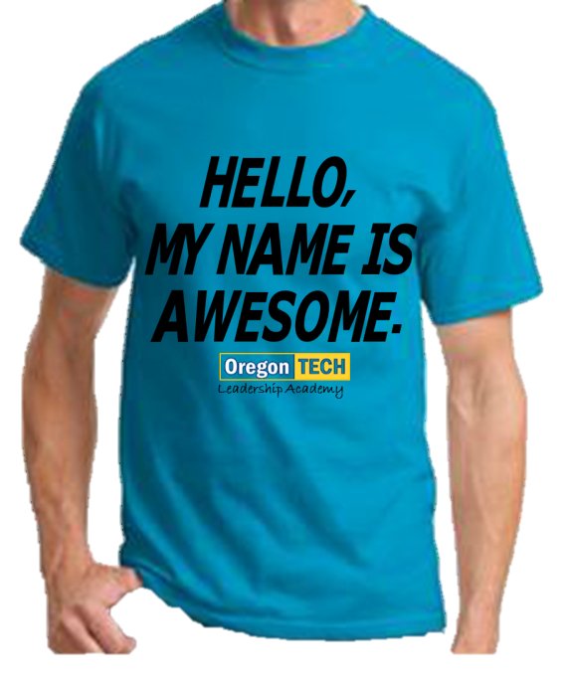
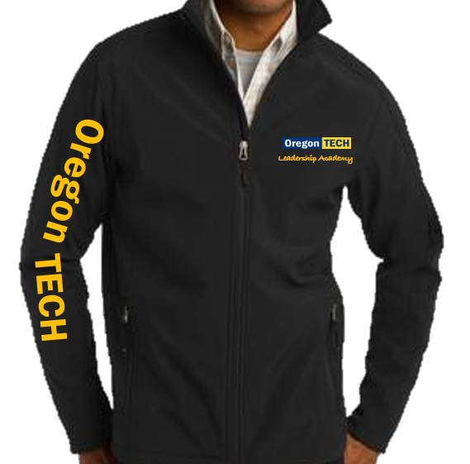
Learn (Year 1)
10 Points- Certificate & T-shirt
Engage (Year 2)
20 Points- T-shirt
30 Points- Certificate & Keychain
Advance (Year 3)
50 Points- T-shirt & Luncheon
60 Points- Certificate & Jacket
Demonstrate (Year 4)
75 Points- Mentor T-shirt & Dinner
100 Points- Certificate & Jacket Patches
150 Points- Leadership Academy Hall of Fame
Points are Cumulative

Slide 13
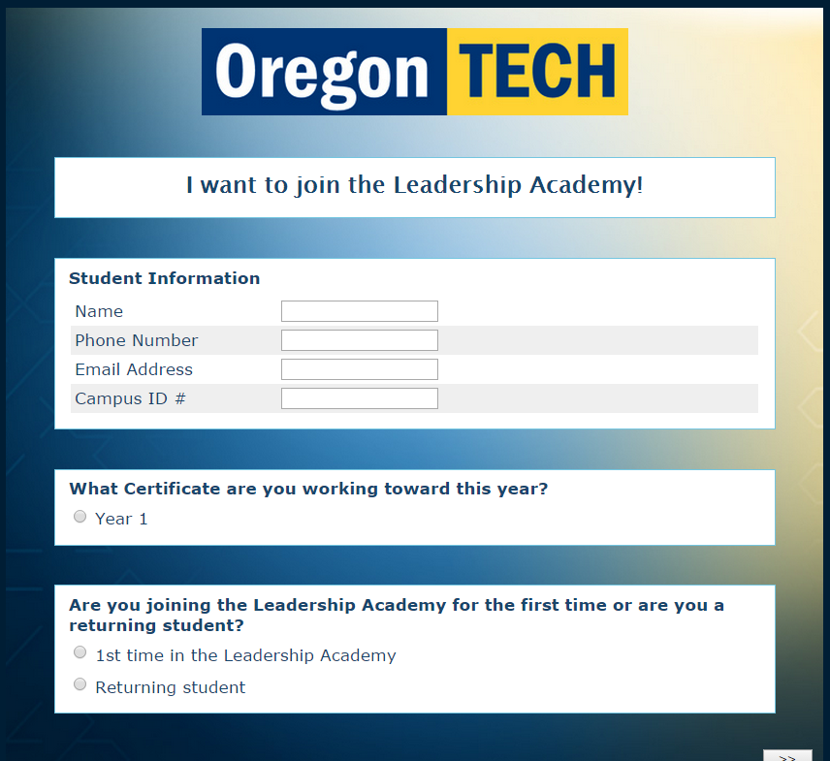
How to Sign Up
Register Today!
Fill out the form
Register Online
Each year we will have a kick-off meeting to preview the schedule
Go to oit.edu/leadershipacademy
Register Now for the Leadership Academy!
Notes:
Register Now for the Leadership Academy!
https://jfe.qualtrics.com/form/SV_es3IbCy0hVMdeGF

Slide 14
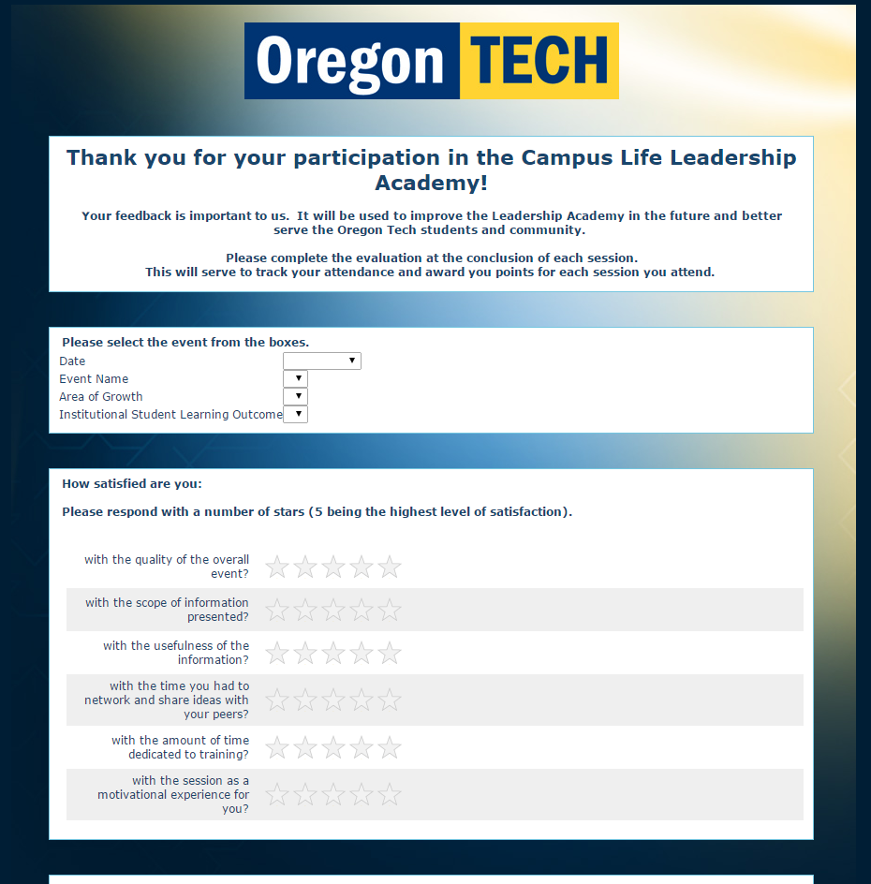
Get Your Points!
Register for the program
Make sure your name and 918# are recorded at the event
Complete an evaluation after each event that you attend
Get Your PRIZES at the awards ceremony!
Notes:
Register Now for the Leadership Academy!
https://jfe.qualtrics.com/form/SV_es3IbCy0hVMdeGF

Slide 15
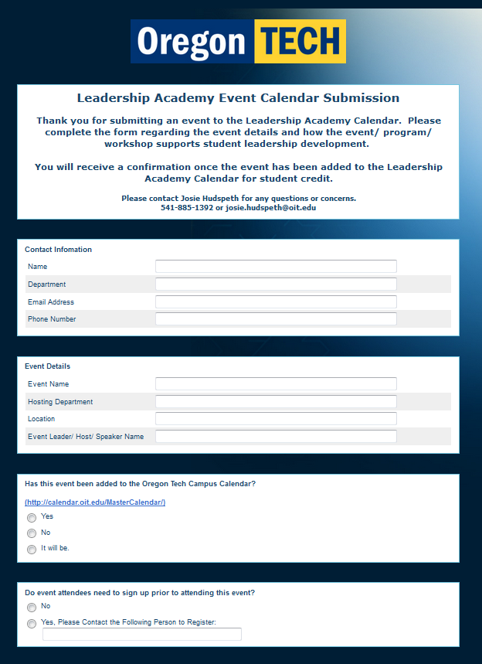
How to Submit an Event to the Leadership Academy Calendar
Complete the online form at oit.edu/leadershipacademy
https://oit.co1.qualtrics.com/SE/?SID=SV_cUO7kye0kK2YHxr
Receive a confirmation
Take attendance
Request that students complete the Event Evaluation at the conclusion of the event to receive participation credit
Notes:
https://oit.co1.qualtrics.com/SE/?SID=SV_cUO7kye0kK2YHxr

Slide 16
Questions & Comments?
Please email any additional questions, comments, or suggestions to josie.hudspeth@oit.edu
Thank you to Sacramento State for sharing your program model and inspiring Oregon Tech’s redesign.

